Slide 1
Revise and refresh for MST124:
Welcome to Session 3
Tuesday 14th September 2021
We’ll start at 7.00pm and aim to finish by 9.00pm
Please check your Audio levels:
Speaker and Microphone Setup
This session will cover the topics in
Linear Equations & Graphs
Please feel free to use the chat box while waiting
Have paper, pen and your calculator to hand.

Slide 2
What we aim to cover tonight
What is an equation?
Why are equations so important?
Linear equations with one variable
Simultaneous linear equations
The graphs of equations
Formulating equations
Notes:
MU123, Unit 7

Slide 3
What is an equation?
An equation consists of two expressions with an equals sign between them. Here are some equations:
From the last session: an expression is a collection of letters, numbers and/or
mathematical symbols. It can be as simple as you like: 0 is an expression, as
well as being a term and a constant.
Notes:
This is a very mathematical and abstract definition. It is important to realise that most equations that you will meet, other than ones invented for assignments and tests, are simply descriptions of real-world situations in the language of mathematics.

Slide 4
Linear Equations in One Variable
multiples of the variable (one variable only)
symbols
constants
BUT NOT

Slide 5
Linear Equations in One Variable
But not
Why not?
Notes:
We call them linear equations because if we graph them, the graph is a straight line. We will be looking at this later. We will also look at why the last equation is not a linear one.

Slide 6
Solving linear equations
What is the value of the variable?
If x + 2 = 5, then x = 3
But what about
Notes:
When we talk about solving equations, we are asking, “what is the value of the variable?” Simple equations can be solved by inspection, or trial and error, but we need a method for the more complicated ones.

Slide 7
Solving linear equations
Notes:
Before I start solving this equation, there is just one thing you need to remember.

Slide 8
The Golden Rule of solving equations
Whatever you do to one
side of an equation,
you must do to the other
Notes:
If you have used the mantra, “take it over the other side and change the sign”, I strongly recommend that you forget it now. It is a gross simplification of the golden rule that works in very basic cases involving addition and subtraction only. If you try to apply it to the more complex equations you will meet in MST124, it will almost certainly get you into trouble.

Slide 9
Solving linear equations
We need to end up with
Notes:
At the moment, we have x’s on both sides, and constants on both sides. The aim of the game is to get all the x’s onto the left-hand side, and all the constants onto the right. We’ll start with the x’s. We have a –x on the right which we don’t want there. Since it is minus x, we can get rid of it by adding, but remember the golden rule. We must add x to both sides.

Slide 10
Solving linear equations
Add x to both sides
Notes:
Now we get rid of the 3 on the left by subtracting 3 from both sides.

Slide 11
Solving linear equations
Add x to both sides
Subtract 3 from both sides
Notes:
Finally, since we want x=, not 3x=, we divide both sides by 3.

Slide 12
Solving linear equations
Add x to both sides
Subtract 3 from both sides
Divide both sides by 3

Slide 13
Checking
Since LHS = RHS, the solution must be correct.
Notes:
You should always check the answer of an equation. It’s so easy to make sure that the answer is right that it’s just throwing marks away not to do so. We check by checking the left and right hand sides separately, and then comparing them. You may have been taught in school that you just substitute the value back into the equation. You can’t really do this, because until you have completed the check you don’t know whether the statement is true or not, and in maths, you are not allowed to make untrue statements.

Slide 14
Some to try

Slide 15
Some to try
If you didn’t have long enough to solve the equations,
have another go at them after the tutorial.
Notes:
If you had any problem with these, type in your query.

Slide 16
Equations with brackets
Notes:
Just one extra step: open out the brackets first.

Slide 17
Equations with brackets
Open out the brackets

Slide 18
Equations with brackets
Open out the brackets
Add 5x to both sides

Slide 19
Equations with brackets
Open out the brackets
Add 5x to both sides
Subtract 2 from both sides

Slide 20
Equations with brackets
Open out the brackets
Add 5x to both sides
Subtract 2 from both sides
Divide both sides by 7

Slide 21
Equations with brackets
Now check the answer. If x = 4
Since LHS = RHS, the solution must be correct.

Slide 22
How not to check
You may have been taught to check like this:
Substituting x = 4 back into the equation gives
This is wrong, for two reasons. Firstly, until you have completed the check, you won’t know whether the first line of the check is true or not. If the answer is wrong, the statement will be untrue, so this is a misuse of the equals sign, and you may lose marks as a result. Secondly, by wording the check in this way, we have started by assuming that the result is correct, and then used it to prove that ten equals ten, which is nonsense. Your written maths must make sense logically. Always check the left- and right-hand sides separately, and then compare them.

Slide 23
Here’s a few for you to try

Slide 24
Here’s a few for you to try

Slide 25
Equations with fractions
Clear the fraction first.
Notes:
The lowest common denominator is 4, so we are going to multiply both sides by 4

Slide 26
Equations with fractions
Note that you must use
brackets round the -5. You
cannot write 4 x -5. The
rules of mathematics do not
allow two signs together
without brackets, as it may
be ambiguous.
Multiply both sides by 4
There is no need to work with fractions
when solving equations. It’s just messy, and
it increases the chances of making a mistake.
Get rid of them! If the answer is a fraction,
that will resolve itself in the final step.
Notes:
It is better to multiply the whole of each side by 4 first, rather than doing it term by term: less chance of making a mistake.

Slide 27
Equations with fractions
Multiply both sides by 4
Open out the brackets

Slide 28
Equations with fractions
Multiply both sides by 4
Open out the brackets
Subtract 12 from both sides

Slide 29
Equations with fractions
Multiply both sides by 4
Open out the brackets
Subtract 12 from both sides
Multiply both sides by -1

Slide 30
Equations with fractions
Now check the answer. If x = 32
Since LHS=RHS, the solution must be correct

Slide 31
Some to try
These equations are a bit more involved.
You do need to be comfortable with
more complex equations when doing MST124.
Don’t worry if you can’t solve them in the
short time you get here. Tackle them
after the tutorial.

Slide 32
Some to try

Slide 33
Summary
1
Multiply both sides by the LCM of any fractions
2
Open out the brackets
3
Collect terms in the variable on the left and constants on the right
4
Simplify to one term on each side
5
Divide both sides by the coefficient of the variable
Notes:
This will cope with most linear equations. You might occasionally come across an equation so complex that it requires some stages to be repeated, but it won’t happen very often.

Slide 34
Is this a linear equation?
Notes:
This is the equation from the earlier frame that looks as if it fulfils the conditions for a linear equation, but does it?

Slide 35
Is this a linear equation?
Multiply both sides by y to clear the fraction
Open out the brackets
And it’s not a linear equation!
Notes:
When equations have variables in the denominator of a fraction, you will need to get rid of the fractions before deciding what sort of equation it is, and hence what technique you are going to use to solve it.

Slide 36
Equations with two variables
What is the solution to
Notes:
Give the students time to answer. Hopefully, we will get several different correct solutions.

Slide 37
Equations with two variables
What is the solution to
x = 2, y = 1
x = ½ , y = 2
x = -1, y = 3
Etc, etc, etc

Slide 38
Equations with two variables
Consider the graph of
You can, if you like, rearrange it as
Notes:
The graph is easier to plot in its y = ... form, but the two equations are the same.

Slide 39
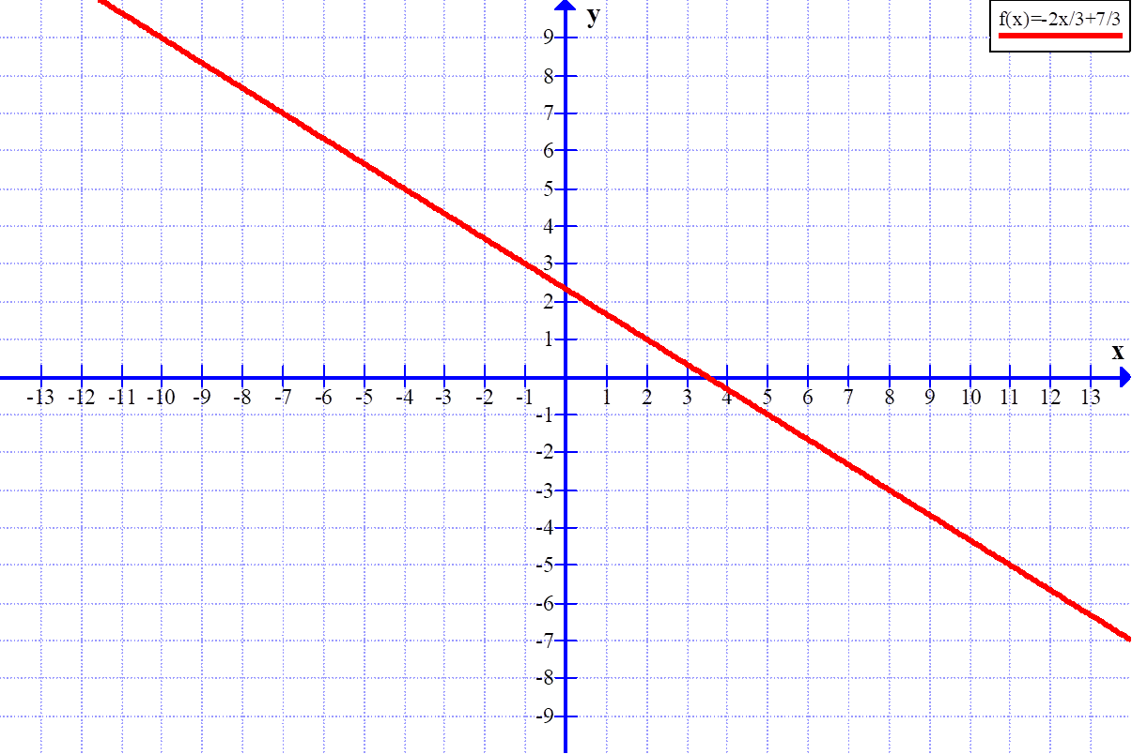
The graph of 2x + 3y = 7
Notes:
Any point on this graph satisfies the condition that 2x + 3y = 7, because that is the way we plotted it. This means that the coordinates of any point are solutions to the equation. There are infinitely many solutions.

Slide 40
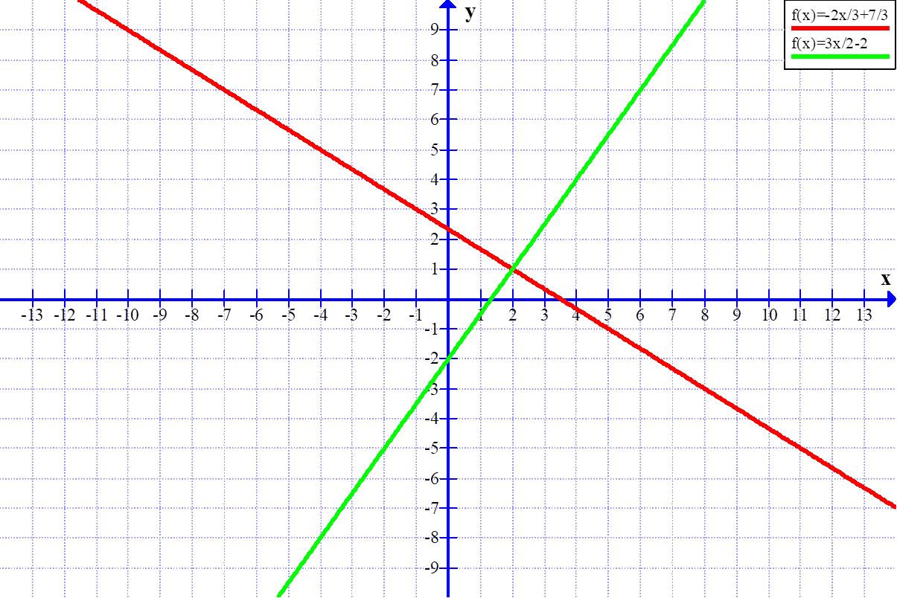
Adding the graph of 3x – 2y = 4
Notes:
Both 3x – 2y = 4 and 2x + 3y = 7, but if we add the condition that both equations are true at the same time, there is only one solution: x = 2 and y = 1

Slide 41
Simultaneous linear equations
If
and
at the same time, there is only one solution:
Notes:
The two equations are true at the same time, so we call them simultaneous equations.

Slide 42
Simultaneous equations: the elimination method
Notes:
We solved those equations graphically, but of course we need a method of doing it algebraically. There are actually two methods: the elimination method, which is often the best one when both equations are simple linear equations, and the substitution method, which can be used in any situation. I’ll start with the elimination method.
Note that if we multiply both sides of the second equation by 2, the coefficient of y will be the same in both equations. (It doesn’t matter if the sign is different.)

Slide 43
Simultaneous equations: the elimination method
Multiply both sides of the second equation by 2 and write the first equation underneath.
Notes:
Because the coefficients of y in both equations are the same, subtracting one equation from the other means that y disappears. If the two terms in y had had different signs, we would have added instead of subtracting. If you are worried about subtracting one equation from another, all we are saying is if a = 28 and b = 12, then a – b = 28 – 12 = 16.

Slide 44
Simultaneous equations: the elimination method
Multiply both sides of the second equation by 2 and write the first equation underneath.
Subtract the equations when
the signs are the same; add
when they are different.
Subtract the equations. Since -2y – (-2y) = 0, the y’s will disappear.
Notes:
Finding the value of x isn’t the end of it. We need to find the value of y as well. We do this by substituting the value we have found for x back into one of the original equations. It doesn’t matter which one. I have chosen the second one because we have y instead of 2y, which makes it slightly easier to solve.

Slide 45
Simultaneous equations: the elimination method
Multiply both sides of the second equation by 2 and write the first equation underneath.
Subtract the equations. Since -2y – (-2y) = 0, the y’s will disappear.
“Substitute” means that
we replace x in the original
equation with its known
value.
Substitute this value into the second equation

Slide 46
Simultaneous equations: the elimination method
Multiply both sides of the second equation by 2 and write the first equation underneath.
Subtract the equations. Since -2y – (-2y) = 0, the y’s will disappear.
Substitute this value into the second equation
Solve this equation for y

Slide 47
Simultaneous equations: the elimination method
Multiply both sides of the second equation by 2 and write the first equation underneath.
Subtract the equations. Since -2y – (-2y) = 0, the y’s will disappear.
Substitute this value into the second equation
Solve this equation for y
So the solution is
Notes:
It is very important to understand that the solution is the x and y values together, and it must be written down as such. I have often seen something like, “the solutions are x = 16 and y = 66”. This is wrong. There is only one solution.

Slide 48
Check the answer
Since we used the second equation to find the value of y, we’ll use the first equation to check the answer.
Since LHS = RHS, the solution is correct.

Slide 49
Simultaneous equations: the substitution method
Rearrange the second equation to make y the subject:
Notes:
I am now going to use the substitution method to solve the same pair of equations. Both methods are useful, but you must make sure that you learn the substitution method, as not all simultaneous equations can be easily solved with the elimination method.

Slide 50
Simultaneous equations: the substitution method
Rearrange the second equation to make y the subject:
Substitute this value for y in the first equation
We replace y in the first
equation with its value,
5x – 14, from the second
equation.
Notes:
“Substitution” means that we replace one value with another. We know from the second equation that y = 5x – 14. Since both equations are true at the same time, this means that y in the first equation is equal to 5x – 14, so we can replace y with 5x – 14. This turns the first equation into a linear equation.

Slide 51
Simultaneous equations: the substitution method
Rearrange the second equation to make y the subject:
Substitute this value for y in the first equation
Then proceed as for a linear equation
means “therefore”.
Don’t put an equals
sign in front of an
equation. It doesn’t
make sense.
Notes:
Need to explain the therefore sign, and why an equals sign in this position is wrong.

Slide 52
Simultaneous equations: the substitution method
Rearrange the second equation to make y the subject:
Substitute this value for y in the first equation
Then proceed as for a linear equation
and we have
Giving as before

Slide 53
Some to have a go at

Slide 54
Some to have a go at

Slide 55
The Graphs of Equations
Consider the linear equation 2x – 4 = 0, whose solution is x = 2
To plot a graph, I need two coordinates, so I am going to plot the graph of y = 2x - 4
Notes:
We have already had a brief look at the graphs of equations. We now need to look at them in greater depth.

Slide 56
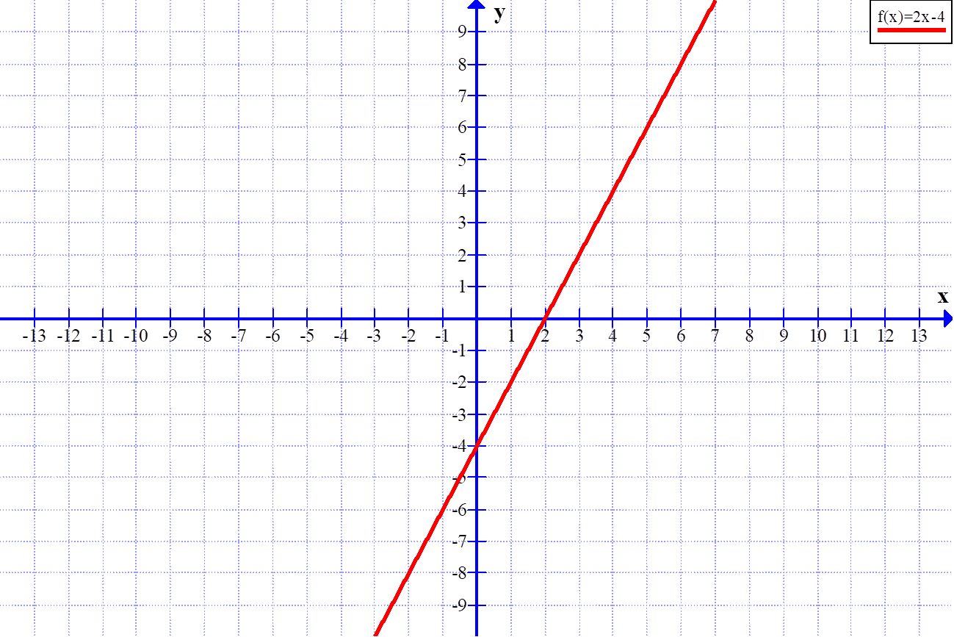
The graph of y = 2x - 4
Notice that putting y = 0
gives us the original equation,
2x – 4 = 0, and where y = 0 on
the graph, we find the solution
of this equation, x = 2.
Notes:
We get a straight line, which is why equations of the type we have been considering a called linear equations.

Slide 57
The general equation
Note that the equation we looked at, y = 2x – 4, is in this form.
Notes:
The general equation of a straight line is written in this form, where m and c are constants (for any given line). x and y then vary to give you the points on the line.

Slide 58
The Gradient
By convention, the gradient is
labelled m. It is found by going
vertically from any point on the
graph and then horizontally back
to the graph. It is the distance
down divided by the distance
across, in this case
m is also the coefficient of
x in the equation. This will
always be the case, provided
the equation is in the form
y = mx + c.
Convention: something that is
done by general agreement,
but isn’t actually a rule.
Notes:
A straight line equation has two important features. The first is how steep it is. We call the measure of its steepness its gradient.

Slide 59
The Intercept
The y-intercept (just called the
intercept if the meaning is clear)
is the y-coordinate where the
line crosses the y-axis. By
convention, it is labelled c, so
here c = -4
y-intercept
c is also the constant in the
equation. This will always be the
case, provided the equation is in
the form y = mx + c.
Notes:
The second important feature is the point where the line crosses the y-axis, called the y-intercept. If there is no chance of misunderstanding, we sometimes just call this the intercept.

Slide 60
Another look at ...
Positive gradient, slopes
up from left to right
Negative gradient, slopes
down from left to right.
Notes:
Explain gradient and intercept of both lines. Point out the implications of the negative gradient of the red line.

Slide 61
Some terminology
Intercept. The point where a line or curve crosses an axis. It is a number, for example, “the y-intercept is -4”.
Intersection. The point where two lines or curves cross. It is a pair of coordinates, for example, “the point of intersection is (2, 1)”.

Slide 62
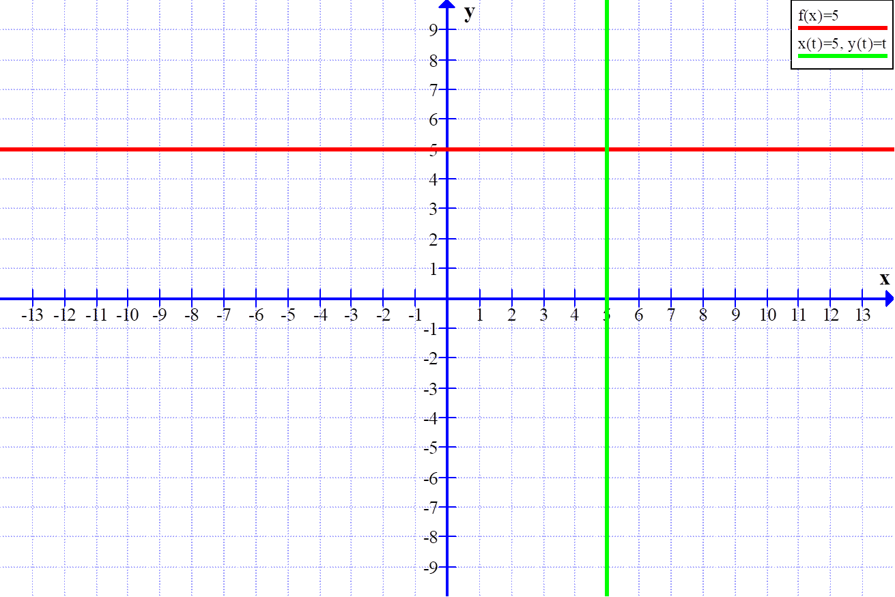
Horizontal and vertical lines
Horizontal line,
zero gradient
Vertical line, no definable
gradient. (Infinity is not
a number.)
Notes:
Note that the line x = 5 is not in the form y = mx + c. This is because, being vertical, it hasn’t got a numerical gradient.

Slide 63
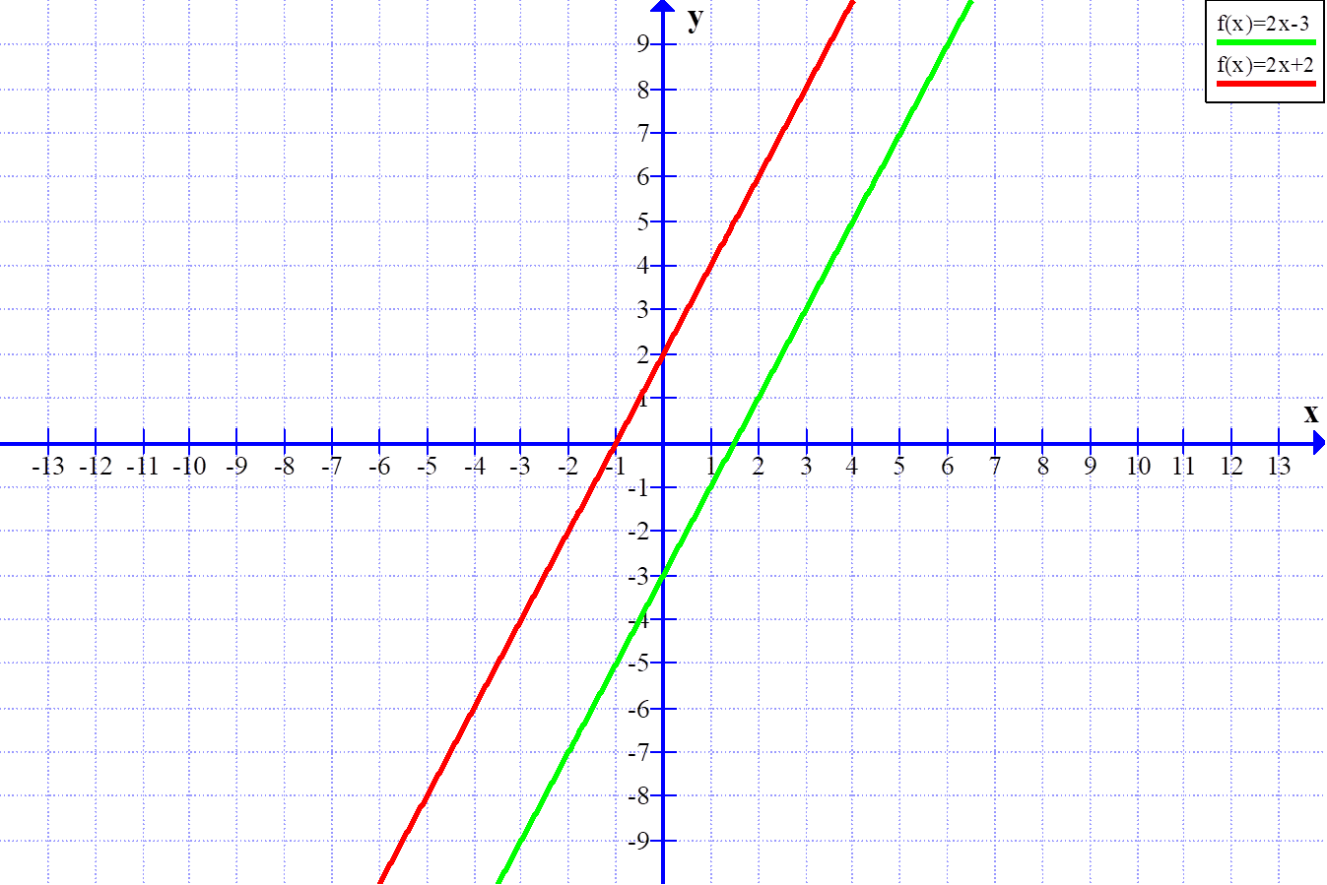
Parallel lines
Parallel lines have the
same gradient

Slide 64
Other useful equations
Completely general form of the equation
of a straight line, to include vertical lines.
Form to use when you know the gradient and
the coordinates of one point .
Formula for the gradient of the line joining the
points . You can combine this
with the equation above to find the equation
of the line joining these two points.
See Unit 2 of MST124, especially Section 2.2, for more information.
Notes:
You need to know, and be able to use, these forms. I don’t have time to go through them in detail here, so you will need to ask.

Slide 65
Formulating equations
It is just as important to be able to formulate equations as it is to be able to solve them, so let’s look at a few problems of this type.
Notes:
I can’t stress enough how important it is to be able to formulate an equation from a piece of information. It is in formulating equations that the deep questions of how the world works are answered. Einstein’s Theories of Relativity, which are the best description we currently have of how the universe works, are just sets of equations, and this is true of most scientific theories and discoveries.

Slide 66
Formulating equations:
Lincoln Cathedral
“How tall is the cathedral?” asked a visitor to Lincoln.
“80 metres plus half its own height”, was the rather unhelpful reply.
Can you help the visitor out, and work out how tall the cathedral spire is?

Slide 67
Lincoln Cathedral
“How tall is the cathedral?” asked a visitor to Lincoln.
“80 metres plus half its own height”, was the rather unhelpful reply.
Can you help the visitor out, and work out how tall the cathedral spire is?
Let the height of the cathedral be h metres. We now have

Slide 68
Lincoln Cathedral
“How tall is the cathedral?” asked a visitor to Lincoln.
“80 metres plus half its own height”, was the rather unhelpful reply.
Can you help the visitor out, and work out how tall the cathedral spire is?
Let the height of the cathedral be h metres. We now have
The height of the cathedral is 80 metres plus half its own height

Slide 69
Lincoln Cathedral
“How tall is the cathedral?” asked a visitor to Lincoln.
“80 metres plus half its own height”, was the rather unhelpful reply.
Can you help the visitor out, and work out how tall the cathedral spire is?
Let the height of the cathedral be h metres. We now have
The height of the cathedral is 80 metres plus half its own height
h = 80 + ½ h
Notes:
Notice that the problem translates directly into the language of mathematics

Slide 70
Lincoln Cathedral

Slide 71
Lincoln Cathedral
Multiply both sides by 2

Slide 72
Lincoln Cathedral
Multiply both sides by 2
Open out the brackets

Slide 73
Lincoln Cathedral
Multiply both sides by 2
Open out the brackets
Subtract h from both sides

Slide 74
Lincoln Cathedral
Multiply both sides by 2
For 283 years, Lincoln Cathedral was the tallest building in the world (the Burj Khalifa of the Middle Ages), but the central spire fell down in 1549.
Open out the brackets
Subtract h from both sides
Write a conclusion
So the height of Lincoln Cathedral is 160 metres.
Notes:
Stress the importance of writing a conclusion.

Slide 75
Formulating Equations: How many stamps
I buy a total of 30 first class and second class stamps for £19.38.
If first class stamps cost 70p each and second class stamps cost 61p each, how many of each type did I buy?

Slide 76
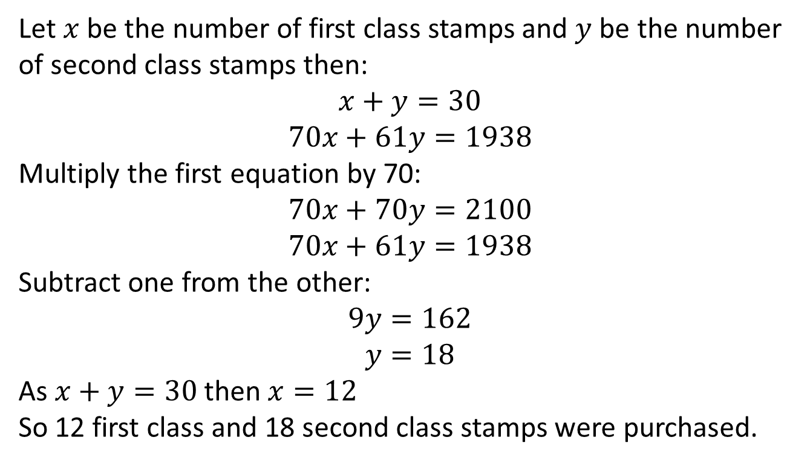
Formulating Equations: How many stamps
Let $$x$$ be the number of first class stamps and $$y$$ be the number of second class stamps then:
$$x+y=30$$
$$70x+61y=1938$$
Multiply the first equation by 70:
$$70x+70y=2100$$
$$70x+61y=1938$$
Subtract one from the other:
$$9y=162$$
$$y=18$$
As $$x+y=30$$ then $$x=12$$
So 12 first class and 18 second class stamps were purchased.

Slide 77
Father and daughter
I am four times as old as my daughter. In 20 years time, I shall be twice as old as my daughter.
How old are we today?
Let the father’s current age be f years, and the daughter’s current age be d years.
We have
Notes:
With two unknowns, we need two pieces of information. The question gives us two pieces of information, leading to two simultaneous equations. In a real-world problem, we might have several unknowns, with several pieces of information that will become equations. As long as the number of equations is equal to the number of unknowns, they can generally be solved.

Slide 78
Father and daughter
Simplify second equation
Substitute for f from first equation
Substitute back into first equation
Now check it!
So the father is 40 years old and the daughter 10 years old.

Slide 79
Why can’t these equations be solved?

Slide 80
Why can’t these equations be solved?
This is an identity (true for
all values of x). If you try to
“solve” it, you’ll end up with 0 = 0.
There are too many variables, so infinitely many solutions

Slide 81
And these pairs of simultaneous equations:

Slide 82
And these pairs of simultaneous equations:
These equations cannot be true
at the same time. If you try to “solve” them, you will probably end up with 14 = 13.
These equations are equivalent,
so there is really only one
equation, not enough for a
unique solution.

Slide 83
Preparing for MST124: Session 4
is on Thursday 16th
We’ll start at 7.00pm and finish at 9.00pm
This session will cover the topics in
Quadratic Expressions and Equations
that you will need to know
Have paper, pen and your calculator to hand.

